Slide 1
Design and Analysis of Algorithms Lab
Dr. Sujata Joshi

Slide 2
Part A
3. “Digishop” a online shopping website needs to keep track of the product availability based on the product ID. Design a program in C to read the product ID provided by the customer and search for it’s availability by using Binary search method . Determine the time required to search for the product. Repeat the experiment for different values of n and plot a graph of the time taken versus n.(n=no of elements).

Slide 3
Binary search
ALGORITHM BinarySearch(A[0..n − 1], K)
//Implements nonrecursive binary search
//Input: An array A[0..n − 1] sorted in ascending order and
// a search key K
//Output: An index of the array’s element that is equal to K
// or −1 if there is no such element
l←0; r ←n − 1
while l ≤ r do
m←(l + r)/2
if K = A[m]
return m
else ifK <A[m]
r ←m − 1
else
l←m + 1
return −1

Slide 4
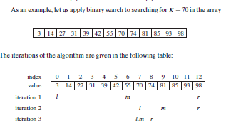
Binary search- Example

